Slide 1
SMART ENERGY METER
With overload protection and home automation
SUBMITTED BY
SAJITH P
720418106302
SUPERVISOR NAME
Mr.M.Pravin.,M.E.(Ph.D.).,
Asst. Prof/ECE Department
CMSCET

Slide 2
SMART ENERGY METERS
INTRODUCTON
The energy consumption can be monitored by using an electric device called energy meter. The cost and the regular usage of Power consumption are informed to the user to overcome high bill usage. The Energy meter shows the amount of energy consumed and transfers the data the customer and to the electrical board, so this helps in reducing man-power. The user can check their Power usage from anywhere and at any time interval. The IoT is used to Turn on/off the energy meter using relay and Arduino interfacing. The objective of this system is to monitor the amount of electricity consumed. The distributer and the consumer both will be benefitted by eventually reducing the total Power consumption.

Slide 3
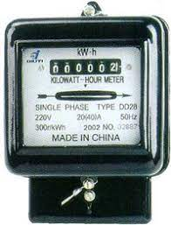
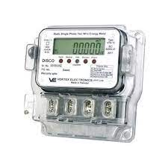
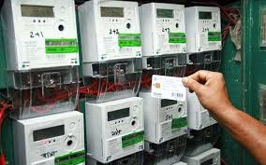
CONVENTIONAL ENERGY METERS
EXISTING SYSTEM
DRAWBACKS
. NO PROTECTION SYSTEM
. USER WILL NOT GET REALTIME REPORTS ON ENERGY CONSUMPTION

Slide 4
PROPOSED SYSTEM
SMART ENERGY METERS
ITS BASICALLY BASED ON ARDUINO&IOT,
APART FROM THE CONVENTIONAL METERS ,ITS MADE BY THE FEATURES OF
IOT BASED COMMUNICATION FOR REAL TIME REPORTS ON ENERGY CONSUMPTION
AUTO-CUTOFF FEATURE WHEN OVERLOAD
CAN TURN ON/OFF THE POWER SUPPLY WITH MOBILE DEVICES
SMART ALARM SYSTEM WHEN IT REACHES A CERTAIN CONSUMPTION OF ENERGY FOR ENERGY SAVING PURPOSE

Slide 5
WHERE IT IS NEEDED
HOTELS/APARTMENTS
(For knowing how much energy consumptions are done by each room,and for charging the respective amount from the customers)
INDUSTRIAL COMPANIES
(For the purpose of getting the reports on each sections about energy consumption & motivate/ warn them ,also for giving awareness on energy consumption)
HOME AUTOMATION
ELECTRICITY BILLING

Slide 6
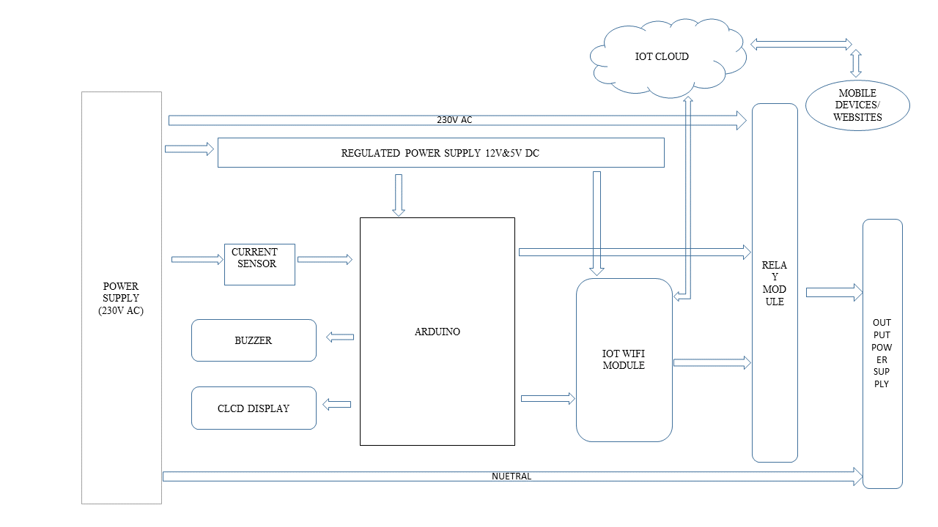
BLOCK DIAGRAM

Slide 7
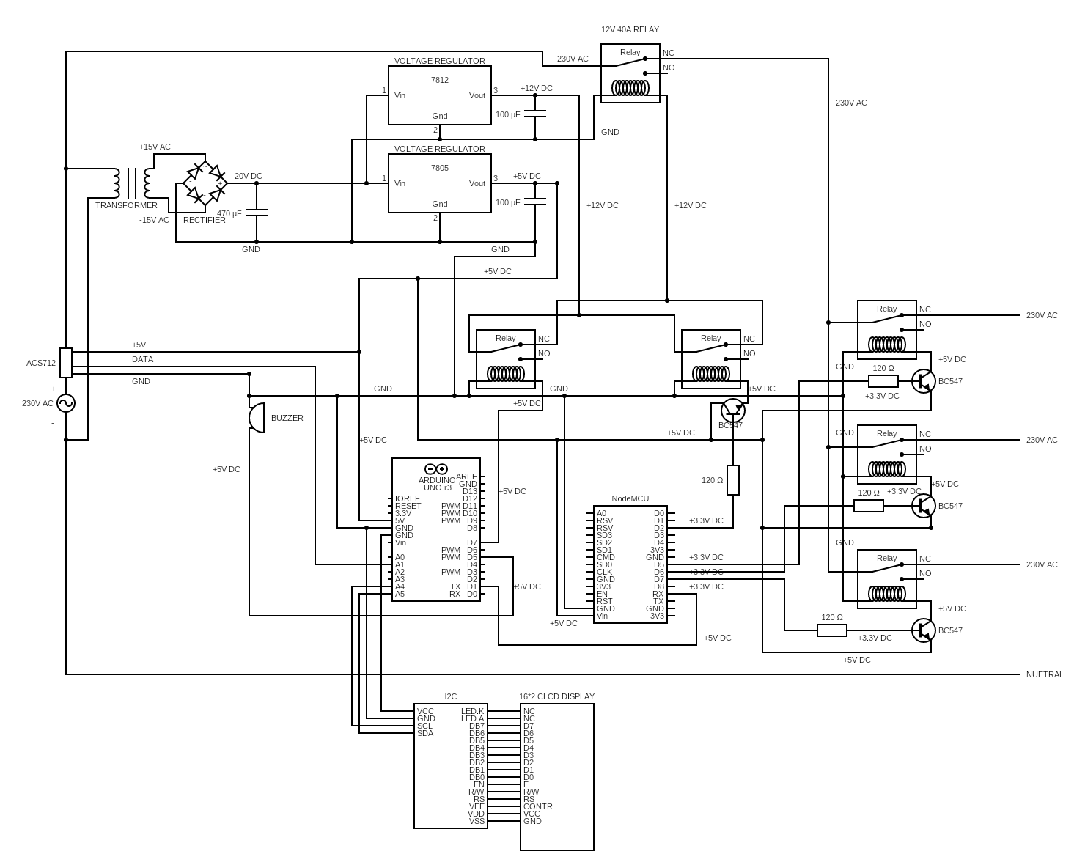
CIRCUIT DIAGRAM

Slide 8
230V
POWER SUPPLY
RECTIFIER AND REGULATOR
+5V
PP
N
+12V
PHASE
NUETRAL

Slide 9
40A RELAY
PHASE
RELAY
RELAY
RELAY
COMMON NUETRAL

Slide 10
40A RELAY
PHASE IN
CURRENT SENSOR
RELAY MODULES
RELAY MODULES
MOBILE DEVICES/WEBSITE
PHASE OUT
ARDUINO
NODE MCU
IOT CLOUD

Slide 11
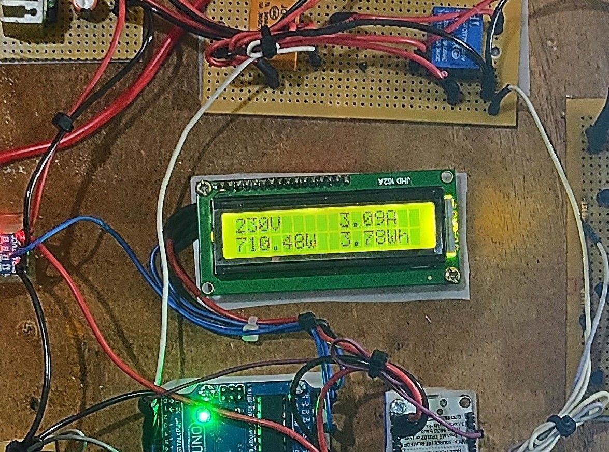
OUTPUT

Slide 12
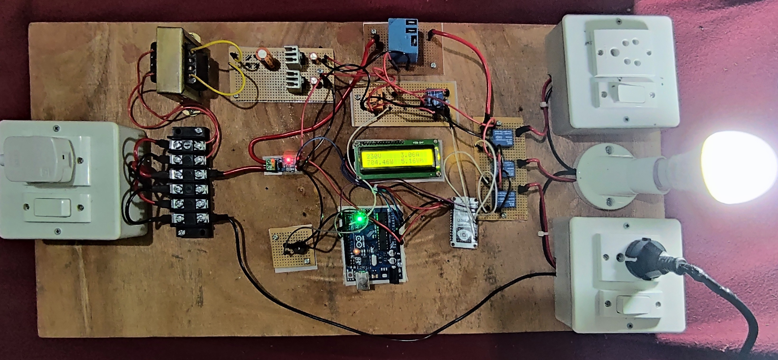

Slide 13
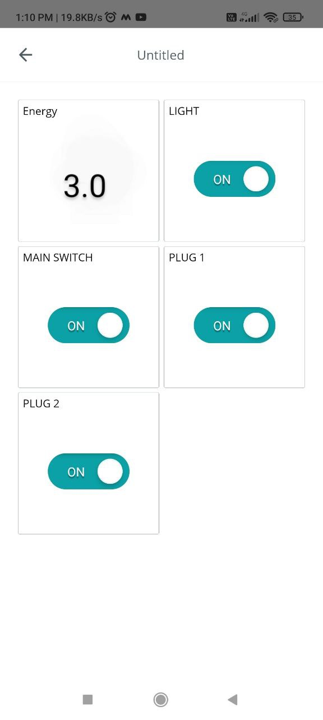

Slide 14
ADVANTAGES
IOT BASED COMMUNICATION FOR REAL TIME REPORTS ON ENERGY CONSUMPTION
AUTO-CUTOFF FEATURE WHEN OVERLOAD
CAN TURN ON/OFF THE POWER SUPPLY WITH MOBILE DEVICES
SMART ALARM SYSTEM WHEN IT REACHES A CERTAIN CONSUMPTION OF ENERGY FOR ENERGY SAVING PURPOSE
APPLICATIONS
HOTELS/APARTMENTS
(FOR KNOWING HOW MUCH ENERGY CONSUMPTIONS ARE DONE BY EACH ROOM,AND FOR CHARGING THE RESPECTIVE AMOUNT FROM THE CUSTOMERS)
INDUSTRIAL COMPANIES
(FOR THE PURPOSE OF GETTING THE REPORTS ON EACH SECTIONS ABOUT ENERGY CONSUMPTION & MOTIVATE/ WARN THEM ,ALSO FOR GIVING AWARENESS ON ENERGY CONSUMPTION)
HOME AUTOMATION
ELECTRICITY BILLING

Slide 15
CONCLUSION
The system would provide a simple way to collect the meter reading and control the equipments without any human involvement. The use of embedded microcontroller and Wi-Fi module increases the stability of wireless data transmission. By using this system the customer can anytime check their consumed energy and control equipments from anywhere in the world

Slide 16
THANK YOU

